Slide 1
Notes : Creational Patterns
As told by the GoF

Slide 2
Intro

Slide 3
What problem do creational patterns solve ?
Creational design patterns make a system “independent of how its objects are created, composed and represented”.
HOW ?
By encapsulating knowledge about the concrete classes the system uses
By hiding the way instances of these classes are created and put together

Slide 4
List of creational patterns
Singleton
Factory Method
Prototype
Abstract Factory
Builder

Slide 5
Singleton
Intent :
ensure there is at most a single instance of a class at any given time
provide access to the instance from any point in the program
Applicability :
There must be a single, globally accessible instance of a class
The instance’s class should be extensible

Slide 6
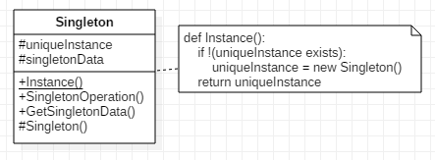
Singleton

Slide 7
Singleton
Consequences :
Controlled access to sole instance thanks to encapsulation
Avoid global variables
Extensibility means that the client can use an instance of the singleton’s subclass
Easily extensible to provide several possible instances
Avoids having static (“class”) functions

Slide 8
Singleton
Implementation details :
The method Instance() returning the unique instance can be implemented as static and test for the existence of the instance.
The class should also have a static uniqueInstance attribute
The constructor and the uniqueInstance should be private to avoid multiple object instantiation
When sub-classing Singleton, choose the subclass to instantiate within the Instance() method or by using a registry of singletons. (Other possibilities exist, see GoF’s Singleton for details)

Slide 9
Factory Method
Intent :
Define an interface for creating objects, but let subclasses decide the class of the object to instantiate
Applicability :
A creator class cannot anticipate the class of the object to instantiate
The class of the object to instantiate is known by the creator’s subclasses
➔ i.e. a creator’s subclass knows which class of product it should create

Slide 10
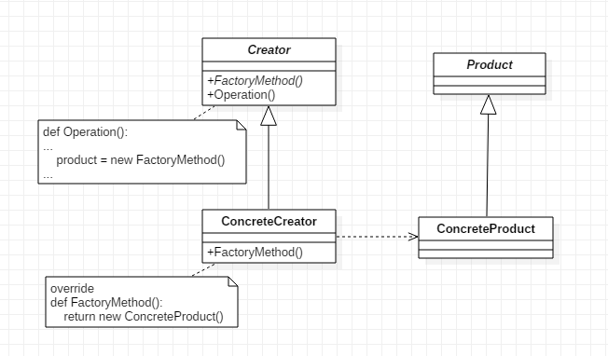
Factory Method

Slide 11
Factory Method
Consequences :
The client does not need to know the ConcreteProduct class that is instantiated : the Product interface is used instead.
Makes creating objects more flexible (virtual method vs direct instantiation).
Connects parallel class hierarchies
Disadvantage : the Creator class needs to be subclassed each time there is a new ConcreteProduct class.

Slide 12
Factory Method
Implementation details :
Either make Creator abstract and implement the factory method within the subclasses, or make Creator concrete and provide a default implementation for the factory method.
Parameterizing the factory method so that it can return several different classes of objects is possible.
Templates can be used in order to avoid subclassing Creator.

Slide 13
Prototype
Intent :
Specify the type using a prototype and create objects by copying it.
Applicability :
The classes to instantiate can be provided at run-time
Buildings a parallel hierarchy of factories needs to be avoided
There is a limited number of different states an instance of the Prototype can have ➔ it may be easier to create the said Prototypes and clone them rather then manually creating the objects.

Slide 14
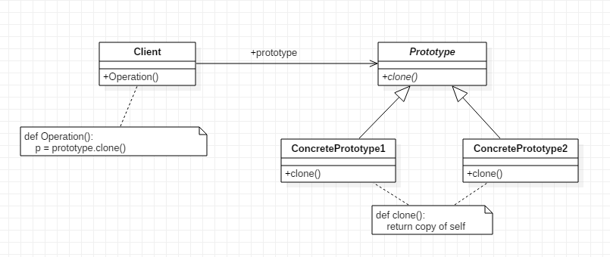
Prototype

Slide 15
Prototype
Consequences :
Concrete classes are hidden from the client.
Products and/or classes can be added at run-time.
Create new kinds of objects by changing the client’s Prototype instance : thanks to object composition, specify the concrete class of objects to be created. ➔ Reduces subclassing an eventual Creator (the object containing the Prototype) as opposed to Factory Method.
Allows reusing the same object as a brick via deep copying.
Disadvantage : defining clone() may be hard, especially if deep cloning is needed or if objects have circular references.

Slide 16
Prototype
Implementation details :
Prototypes can be stored inside a Prototype Manager.
Cloning can be difficult.
An Initialize() method can be added to the Prototype in order to configure its state after cloning.

Slide 17
Abstract Factory
Intent :
Applicability :

Slide 18
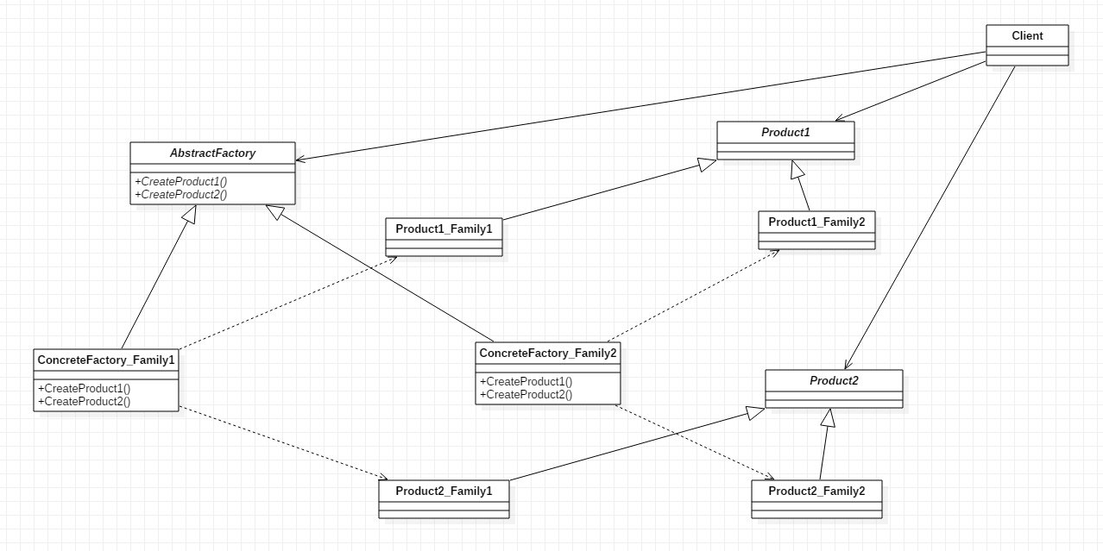
Abstract Factory

Slide 19
Abstract Factory
Consequences :

Slide 20
Abstract Factory
Implementation details :
Can be implemented using either Factory Method or Prototype.

Slide 21
Builder
Intent :
Applicability :

Slide 22
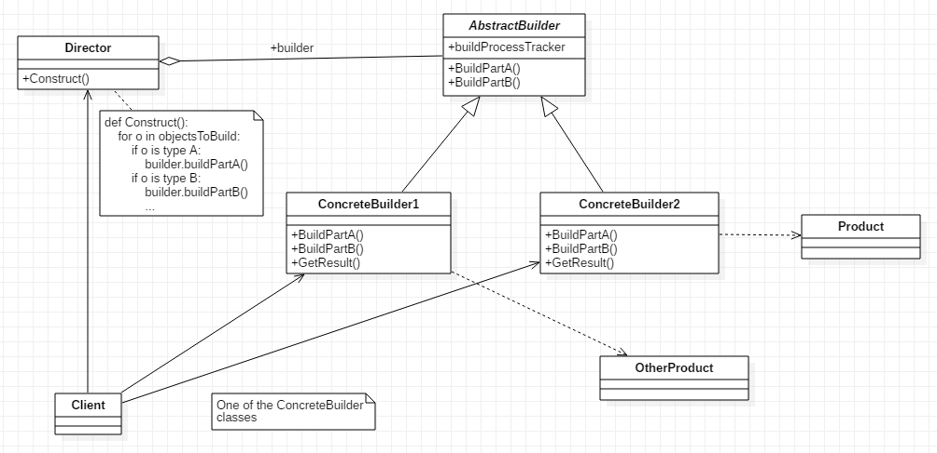
Builder

Slide 23
Builder
Consequences :

Slide 24
Builder
Implementation details :

Slide 25
Creational Patterns
Conclusion :

